Slide 1
Implementing JSP tag extensions

Slide 2

Agenda
Understand and use jsp: tags
Developing JSP pages using custom tags

Slide 3
Use of JSP custom tag
Custom tag is a user defined JSP language element
It is translated into servlet
Tag is converted into operation on tag handler
Container invokes those operation on the JSP page
Three types of tag
Simple tag
Tags with attributes
Tags with body content

Slide 4
Use of JSP custom tag
Java-based tags
Components of a tag library
Basic tags
Tags that use attributes
Tags that use body content
Tags that optionally use body content
JSP-based tags (tag files)
Components of a tag library
Basic tags
Tags that use attributes
Tags that use body content

Slide 5
Components that make up a tag library
The Tag Handler Class
Java code that says what to output
Must implement javax.servlet.jsp.tagext.SimpleTag
Usually extends SimpleTagSupport
Goes in same directories as servlet class files and bean
The Tag Library Descriptor File
XML file describing tag name, attributes, and implementing tag handler class
Goes under WEB-IN
The JSP File
Imports a tag library (referencing URL of descriptor file)
Defines tag prefix
Uses tags

Slide 6
Simple illustration
Create a java class that acts as a tag handler
package mytag;
import javax.servlet.jsp.tagext.*;
import javax.servlet.jsp.*;
import java.io.*;
public class HelloTag extends SimpleTagSupport
{
public void doTag() throws JspException, IOException {
JspWriter out = getJspContext().getOut(); out.println("Hello Custom Tag!");
} }

Slide 7
Simple illustration
compile above class and copy it in a directory available in environment variable CLASSPATH. Finally create following tag library file: <Tomcat-Installation-Directory>webapps\ROOT\WEB-INF\custom.tld.
<taglib>
<tlib-version>1.0</tlib-version>
<jsp-version>2.0</jsp-version>
<short-name>Example TLD</short-name>
<tag> <name>Hello</name>
<tag-class>mytag.HelloTag</tag-class>
<body-content>empty</body-content> </tag>
</taglib>

Slide 8
Simple illustration
Now it's time to use above defined custom tag Hello in our JSP program as follows
<%@ taglib prefix="ex" uri="WEB-INF/custom.tld"%>
<html> <head>
<title>A sample custom tag</title>
</head>
<body>
<ex:Hello/>
</body>
</html>

Slide 9
Accessing tag with body content
Consider you want to define a custom tag named <ex:Hello> and you want to use it in the following fashion with a body:
<ex:Hello>
This is message body
</ex:Hello>

Slide 10
Tag file
package mytag;
import javax.servlet.jsp.tagext.*;
import javax.servlet.jsp.*;
import java.io.*;
public class HelloTag extends SimpleTagSupport {
StringWriter sw = new StringWriter();
public void doTag() throws JspException, IOException {
getJspBody().invoke(sw);
getJspContext().getOut().println(sw.toString());
}
}

Slide 11
TLD
<taglib>
<tlib-version>1.0</tlib-version>
<jsp-version>2.0</jsp-version>
<short-name>Example TLD with Body</short-name>
<tag> <name>Hello</name>
<tag-class>com.tutorialspoint.HelloTag</tag-class>
<body-content>scriptless</body-content>
</tag>
</taglib>

Slide 12
JSP
<%@ taglib prefix="ex" uri="WEB-INF/custom.tld"%>
<html>
<head>
<title>A sample custom tag</title>
</head>
<body>
<ex:Hello> This is message body </ex:Hello>
</body>
</html>

Slide 13
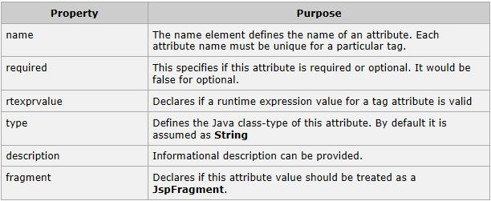
Elements in TLD

Slide 14
Summary
For each custom (Java-based) tag, you need
A tag handler class (usually extending SimpleTagSupport
An entry in a Tag Library Descriptor file
A JSP file that imports it, specifies prefix, and uses it
Simple tags
Generate output in doTag, body-content is empty
Attributes
Define setAttributeName method.
Add attribute entries to TLD file.
Body content
body-content is scriptless
doTag calls getJspBody().invoke(null)

